Slide 1
AWS Cost Optimization
Majid Kamyab

Slide 2


Executive Summary
Cost savings in NFL
Notes:
In this presentation, we explore various methods for cost savings within AWS. We delve into the cost-saving aspects related to NFL initially, followed by a detailed showcase of the technical aspects.

Slide 3
Sandbox account
nfl-data-bi-sandbox savings, ~20000$ per month

Slide 4
Production account
nfl-data-bi savings, ~110000$ per month

Slide 5
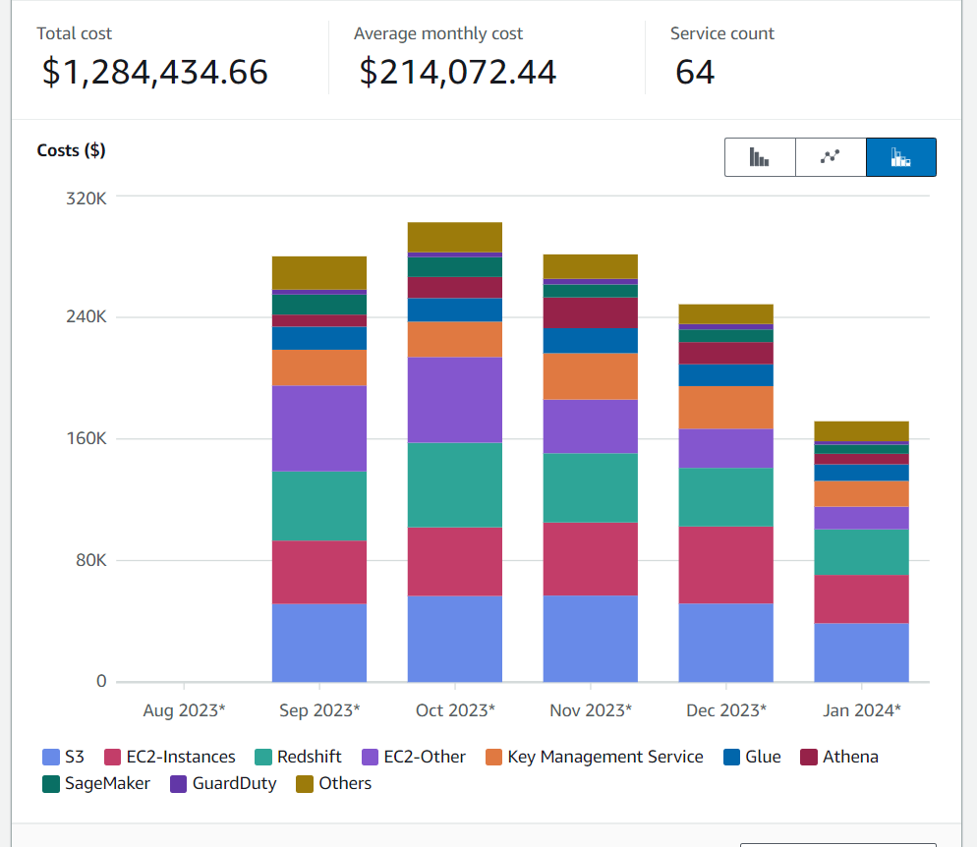
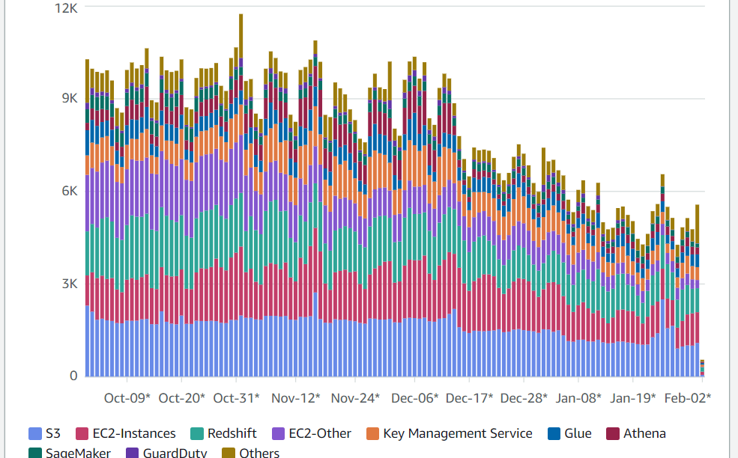
Executive Summary
302K$ in October, 171K$ in January

Slide 6




Tools used
Cost Explorer:
Cost optimizer:
S3 Storage lens:
Trusted advisor.
Use daily cost to find the high cost resources
Unused:
Use cost allocation tags.
Use hourly based to find costs.
Pinpointing underutilized compute EC2/ECS.
KMS and s3 cost finding.
All sort of cost optimization but not as comprehensive.

Slide 7




Example of Actions Implemented in NFL
S3:
Redshift:
KMS:
Athena.
How to find:
S3 storage lens
How to optimize:
lifecycle rules
Intelligent tiering.
How to find:
Cluster monitoring in redshift
How to optimize: schedules, resizing, change to serverless,
Concurrency scaling, reservation
How to find:
Looking for decrypts in S3 Lens.
How to optimize:
Enabling bucket key
How to find:
Utilization of boto3 scripts to track high-cost queries.
How to optimize:
Reuse queries, save queries

Slide 8




Example of Actions Implemented in NFL
Glue:
EC2, EC2-Other:
Sagemaker:
MWAA.
How to find:
Boto3 scripts
How to optimize:
Spark UI
How to find: boto3 script, ec2 console.
How to optimize:
Archiving of snapshots.
Reservation of compute instances.
CloudWatch alarm actions.
reserved nodes/compute.
How to find:
Enable cloudwatch metrics
How to optimize:
lifecycle configurations
Cloudwatch alarm actions
How to find: ???
How to optimize:
Replace with Eventbridge and step function
Downsizing based on DAGs.

Slide 9
Conclusion and what we have learned.
Accountability (FinOps) is the key to cost optimization since Knowing who owns what when starting something is way easier to find them later.
AWS cost explorer cost allocation tags and groups.

